Slide 1
An Automated Advisor Assistant
Kyle Lothian and Ricardo Gomez

Slide 2
Outline
Business Value
Introduction and Benefits
Software Tools Utilized
Java Classes and Their Functions
Program In Action
Future Work

Slide 3
Business Value
Automated
More direct
Potential Mobile app for Students and Faculty
Non-intrusive

Slide 4
Introduction
Goal: create an assistant tool that creates an unofficial degree audit for a student.
Automatically downloads a student’s transcript once they login and display all relevant results to the user on the screen.
Information is cross-referenced to an official degree curriculum so that the user can see what courses s/he has not taken yet, needs to retake, or can take in place of another class.

Slide 5
Benefits
Student is prepared to meet with advisor.
Is aware of their current academic standing.
More user friendly/ aesthetically pleasing method of verifying grades or future classes.

Slide 6



Software Tools Utilized
Selenium
Chromedriver
Netbeans IDE 8.2
Java SE Development Kit (JDK) 8

Slide 7
Java Classes
LoginDialog
Auth
Course
Equiv
DegreeAudit

Slide 8
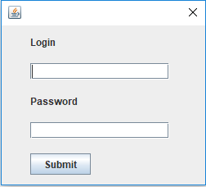
LoginDialog
Provide WebAdvisor credentials
Stores the username and password as Strings to be used within the Auth class

Slide 9
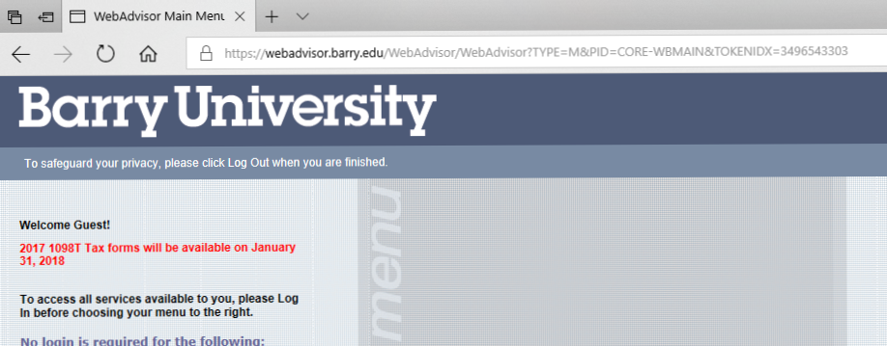
Selenium
A new session “TOKENIDX” is randomly generated for each instance of WebAdvisor. Thus a direct html URL path to the student’s transcript page is unfeasible.
Selenium, with the proper values and tags fed to it, can automatically navigate through the WebAdvisor’s menus to the transcript page.

Slide 10
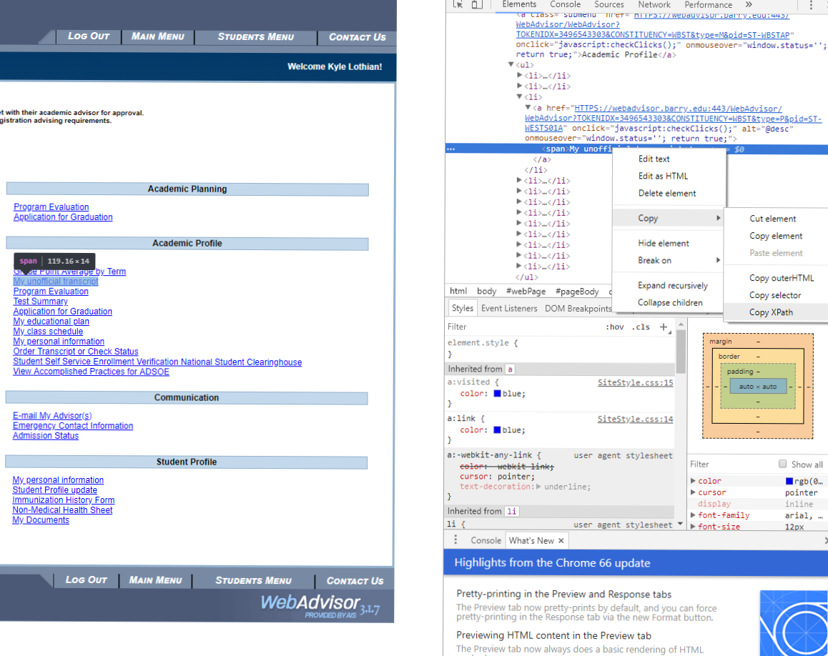

Slide 11
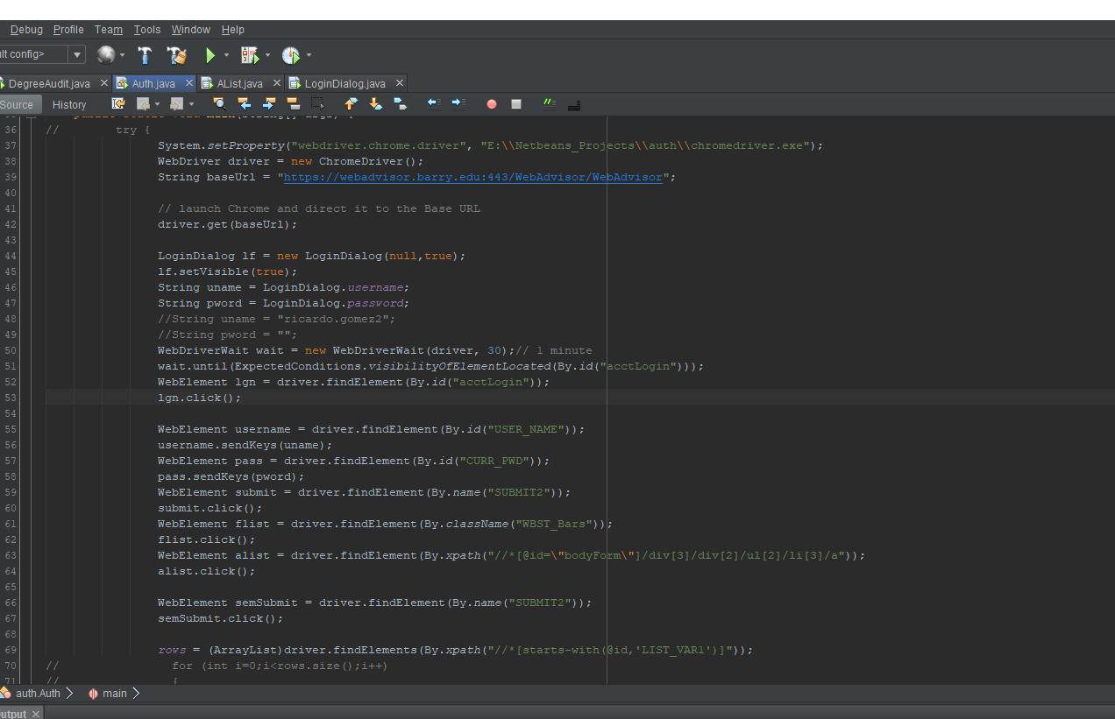

Slide 12
Auth
Extracts relevant information from student transcript.
Sends to inner class “courses” which returns organized class information.
Information is sorted, prepared, and entered as an index within the ArrayList of object type <courses>- named “transcript”
Inner class “equiv” that stores courses and other courses that can be academically equivalent to them.

Slide 13
DegreeAudit
Utilizes methods that populate various ArrayLists, such as required math/cs courses to be taken, electives, course equivalencies, etc.
Multiple methods that iterate through the lists to see if the student has fulfilled any of the courses requirements.
Example: Method “listCSElectiveCourses” .
Displays courses with a passing grade, transferred classes, and classes that are currently being taken or will be taken to the appropriate text area.

Slide 14
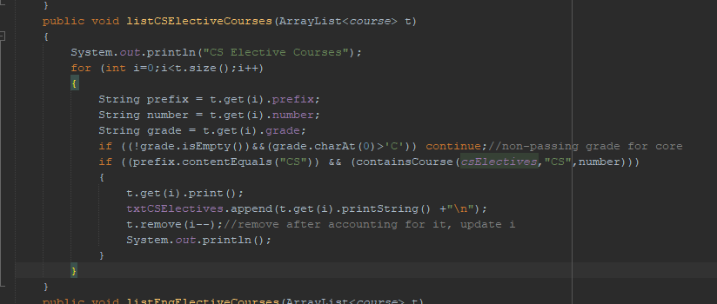
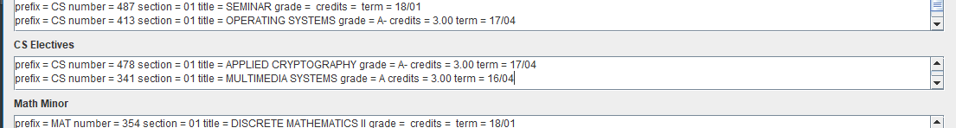
DegreeAudit

Slide 15
DegreeAudit
Features giving the student a recommendation for possible course substitutions.
Compares student’s upcoming courses with those in the equiv class.
If the student has not yet taken a class with an equivalence, a suggestion will be presented.

Slide 16
Equivalence Algorithms
Can use bin packing
Greedy Algorithm

Slide 17
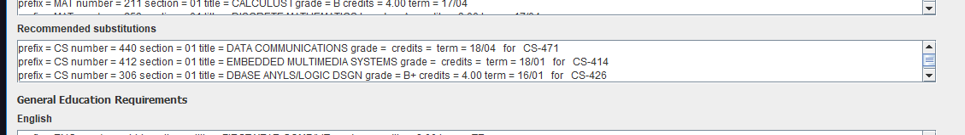
DegreeAudit

Slide 18
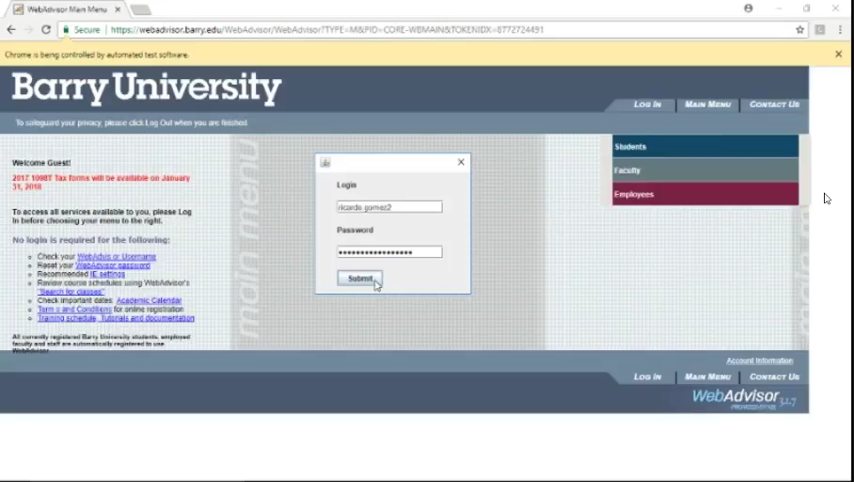
Program in Action

Slide 19
Future Work
Transfer prototype into a mobile form.
Expand this program to work with other majors.
Develop an advisor and registrar oriented version.
Determine student status and function accordingly (transfer students, freshmen, major changes)
Add entry forms for authority figures to modify degree components

Slide 20
References
Selenium - Web Browser Automation (Version 3.11.0) [Computer software]. (n.d.). Retrieved from https://www.seleniumhq.org/
ChromeDriver - Web Driver for Chrome (Version 2.37) [Computer software]. (n.d.). Retrieved from https://sites.google.com/a/chromium.org/chromedriver/

